Slide 1
Information Technology concepts, components and Hands-on
MQTT

Slide 2



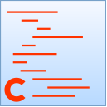
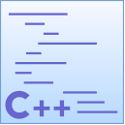
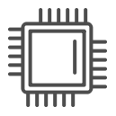
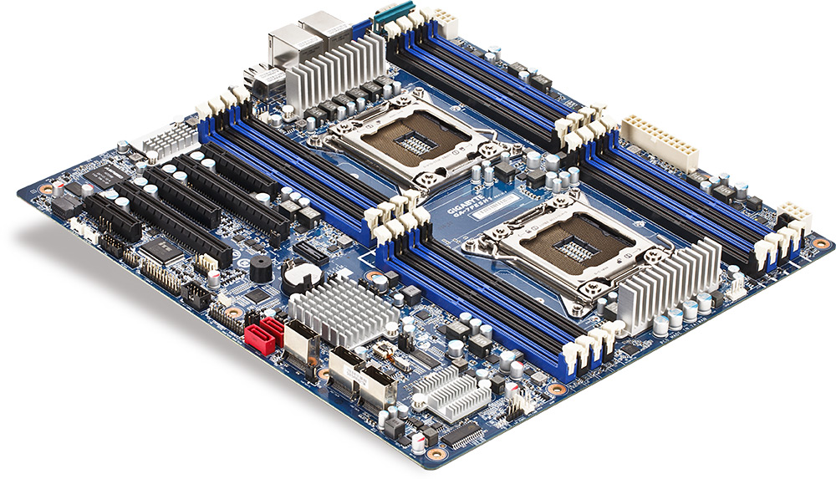
The Information Technology
Mechanisms and technologies to handle the electronic data lifecycle
Software: a set of instructions and its associated documentations that tells a computer what to do or how to perform a task. Can be open-source or proprietary.
Application Software (e.g. word processors and browsers)
Operating Systems (e.g. Microsoft Windows and Ubuntu)
Development softwares (create Application and System software)
Works with a programming language (e.g. C++)
Hardware: the physical parts that make up a computer or a device (e.g., processor, memory, and peripherals).
Are programmed by the vendor via firmwares, a software that provides low-level control or a simple operating environment
Two distinct hardware components are the Microcontrollers and Microprocessors
Windows XP is made of 45M lines of code
Notes:
Mechanisms, such as storing, indexing, processing
Technologies, such as computers, networks and any other physical device
Lifecycle: creation -> (distributed) processing -> deletion
Type of softwares: https://simple.m.wikipedia.org/wiki/Software
Source Windows XP lines of code: https://www.facebook.com/windows/posts/155741344475532

Slide 3
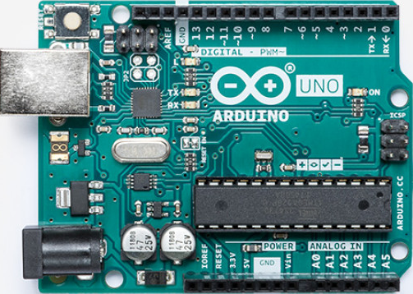
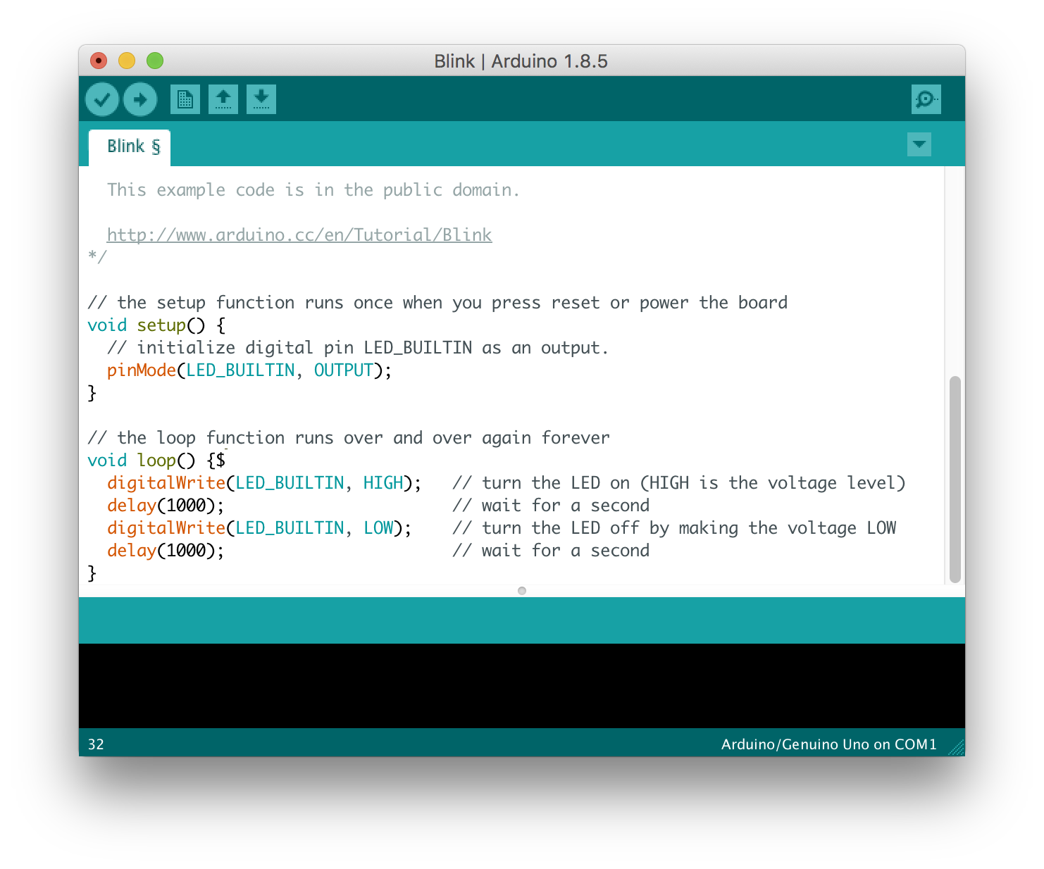
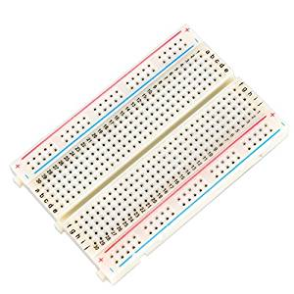
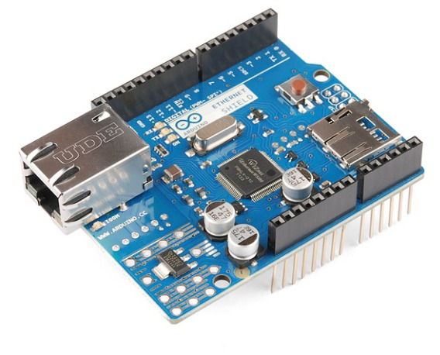
Arduino
A microcontroller-based board and a development software for the rapid prototyping
Inexpensive microcontroller platform
Nano, Uno, Mega..
Cross-platform development software
Arduino IDE
Open source and extensible software
C++ libraries / AVR C
Open source and extensible hardware
Breadboard version
Functionalities via shields and (typically) breadboards
The Arduino Uno
The Arduino IDE
The Arduino Ethernet shield
A breadboard

Slide 4
Arduino flavours
 | Boards
 | UNO (Rev.3) | Nano | Mega
Microcontroller | ATmega328P | ATmega328P | ATmega2560
Operating Voltage | 5V | 5V | 5V
Input Voltage (recommended) | 7-12V | 7-12V | 7-12V
Digital I/O Pins | 14 (of which 6 provide PWM output) | 22 (6 of which are PWM) | 54 (of which 15 provide PWM output)
Analog Input Pins | 6 | 8 | 16
DC Current per I/O Pin | 20 mA | 40 mA (I/O Pins) | 20 mA
DC Current for 3.3V Pin | 50 mA | / | 50 mA
Flash Memory | 32 KB (ATmega328P) of which 0.5 KB used by bootloader | 32 KB (ATmega328P) of which 2 KB used by bootloader | 256 KB of which 8 KB used by bootloader
SRAM | 2 KB (ATmega328P) | 2 KB (ATmega328P) | 8 KB
EEPROM | 1 KB (ATmega328P) | 1 KB (ATmega328P) | 4 KB
Clock Speed | 16 MHz | 16 MHz | 16 MHz
Length | 68.6 mm | 18 mm | 101.52 mm
Width | 53.4 mm | 45 mm | 53.3 mm
Weight | 25 g | 7 g | 37 g
Additional | Led at PIN 13, Reset button, ICSP | Led at PIN 13 | Led at PIN 13, Reset button, ICSP

Slide 5
The Arduino IDE
Easy configuration
Tools -> Serial Port
Tools -> board
Connecting the board
USB to power the board, upload the code and receive data
Serial connection for debug (Serial Monitor) and communication
Arduino program
Setup() and Loop()
Program as C/C++
Notes:
Follow https://www.tweaking4all.com/hardware/arduino/arduino-programming-course/arduino-programming-part-2/#YourBasicArduinoProgramLayout

Slide 6


Assignment 1
Know your Arduino
Download and install the IDE
Connect the board and make on-board led blink
15 minutes

Slide 7
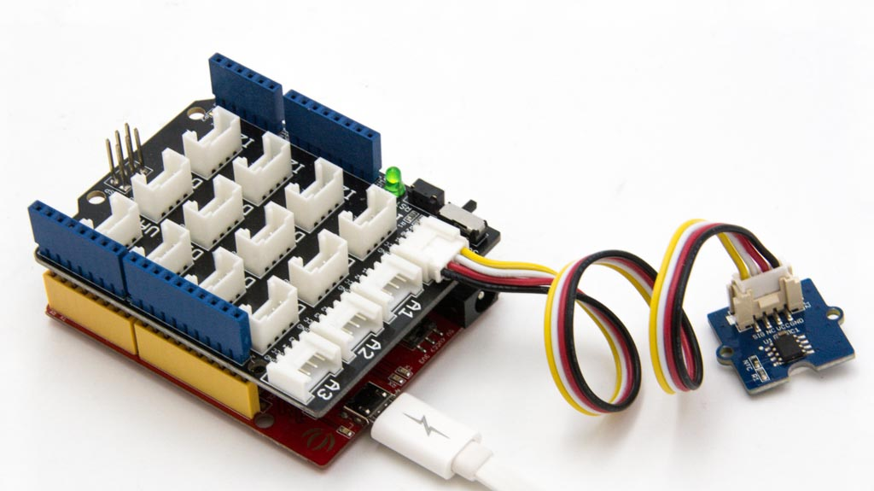

The Grove prototypying system
A modular, standardized connector prototyping system
No jumpers or soldering
Grove sensors plugged on the Grove shield
Documented sensors
Libraries
Expand the sketch provided for your development board (mainly Arduino and Raspberry Pi)
Verify version, type of sensor (Analog or Digital) and voltage

Slide 8
Assignment 2
Connect the provided Grove sensor and follow the tutorial in the official documentation
20 minutes

Slide 9
Assignment 3
Add one sensor and connect their features (e.g. turn on led if sensor signal the vibration)
20 minutes

Slide 10
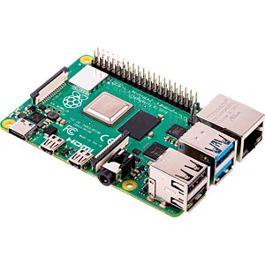
Raspberry Pi
Basically a small computer
Connectivity
LAN, Wi-Fi and Bluetooth
Ports
HDMI, audio, USB and LCD
Operating system
Out-of-the-box usage
Multi-tasking
Missing analog-to-digital converter
But also supports Grove prototyping system

Slide 11
Assignment 4
Install Arduino IDE on the Raspberry Pi and acquire sensor data using the emulated serial port
20 minutes

